Slide 1
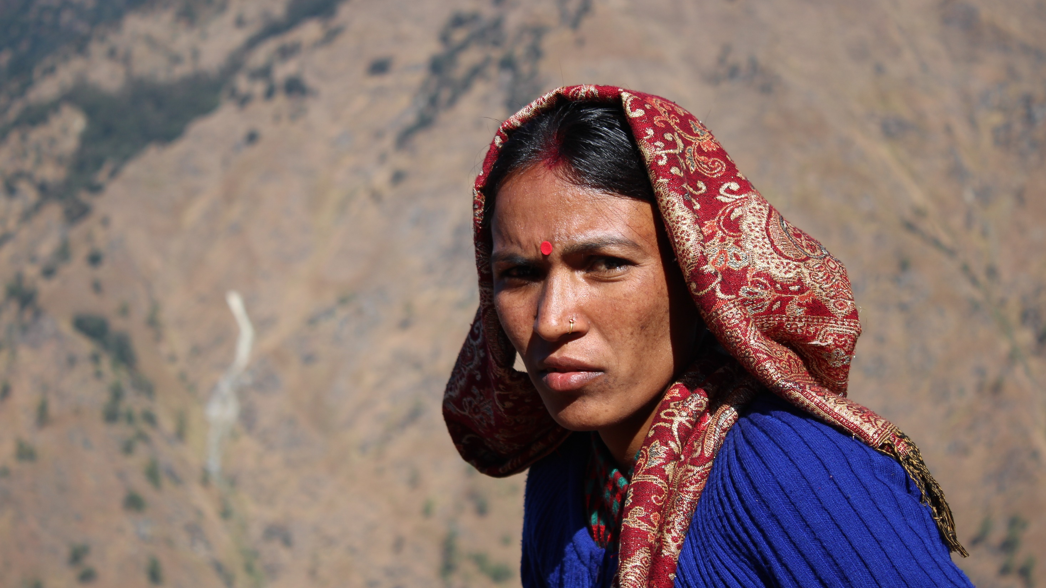

She speaks – She is heard
Kailash Initiative
8 March 2022 – International Women’s Day

Slide 2


Slide 3
Origins & history
Prakriti Ahwaan
In situ actions
Local government plans
Federal government dialogue
2018
2019
2020
2021
2022
Consensus on GESI in NRM
Training local governments
Preparing plans
Engaging provincial government
Finalizing plans
Endorsement
Engaging line ministries
Way forward

Slide 4
A Theory of Change
Context
1° Pathways
Intermediate outcome
2° Pathways
Expected result
GESI-responsive planning
Inclusive planning
Capacity building
Technical support
Inclusive resource management to:
meet people’s needs
reduce threats to biodiversity
GESI-blind NRM planning
Policy guidelines
Lessons learned
Adapt methodology
Plan preparation
Opportunity for local level planning
5-year planning cycles of local governments
Policy dialogues
Assumptions:
Enabling policy environment
Active participation of local governments
Stakeholder engagement

Slide 5






Stakeholders
Implementers
Target institutions
Beneficiaries
KSLCDI
Local government
Provincial government
Federal government
Local communities
Women & men
Social minorities
Ethnic groups
HIMAWANTI Nepal

Slide 6
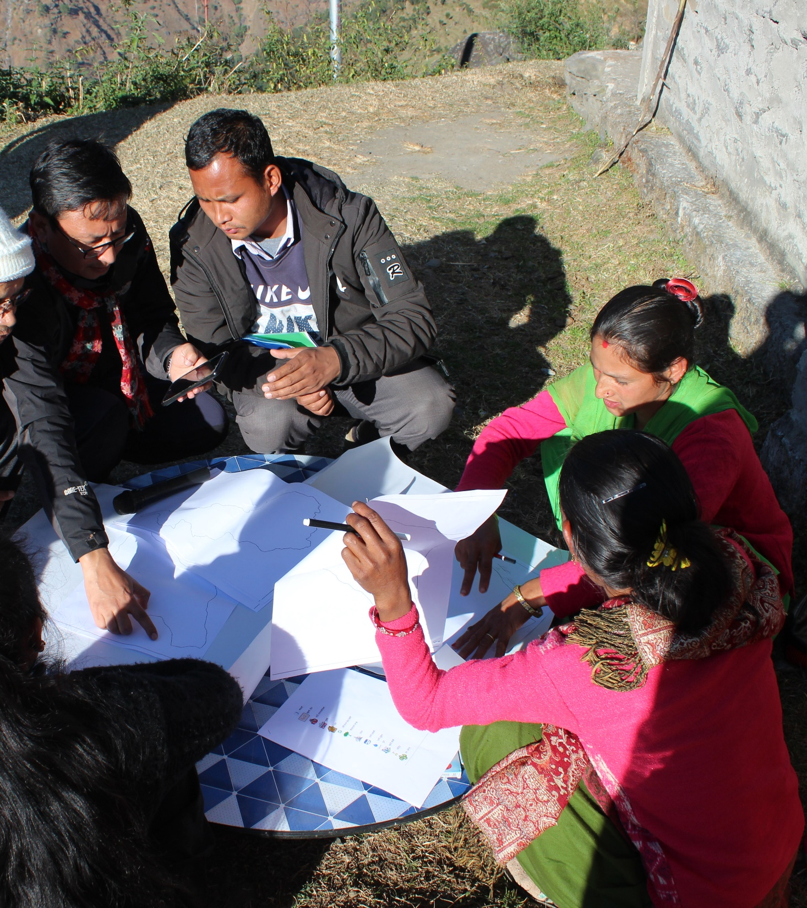
Achievements
2
5-year GESI-responsive NRM plans prepared and endorsed
3
Levels of governments engaged – local, provincial, federal
57
Officials and stakeholders trained
33% women
28% ethnic & social minorities
16,121
Reach
51% women
19% ethnic & social minorities

Slide 7
Way forward
Policy
Upscaling at national level
Capacity building
Training manual
Training of Trainers (ToTs)
Outscaling
Sharing with KSL-India
Other HKH countries as relevant
MoFAGA policy guideline

Slide 8
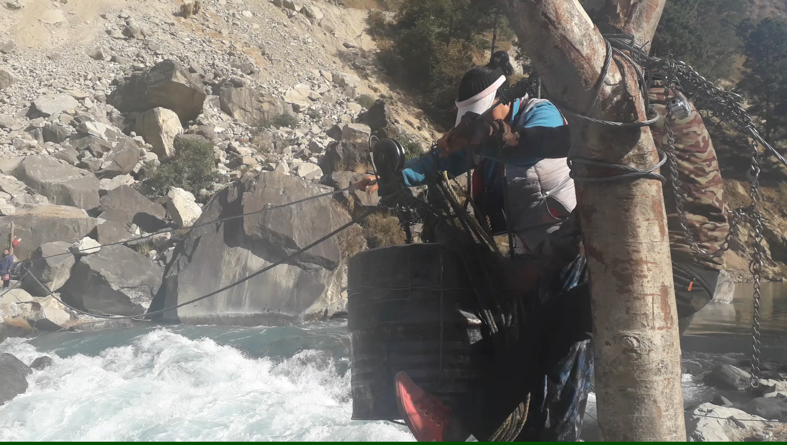
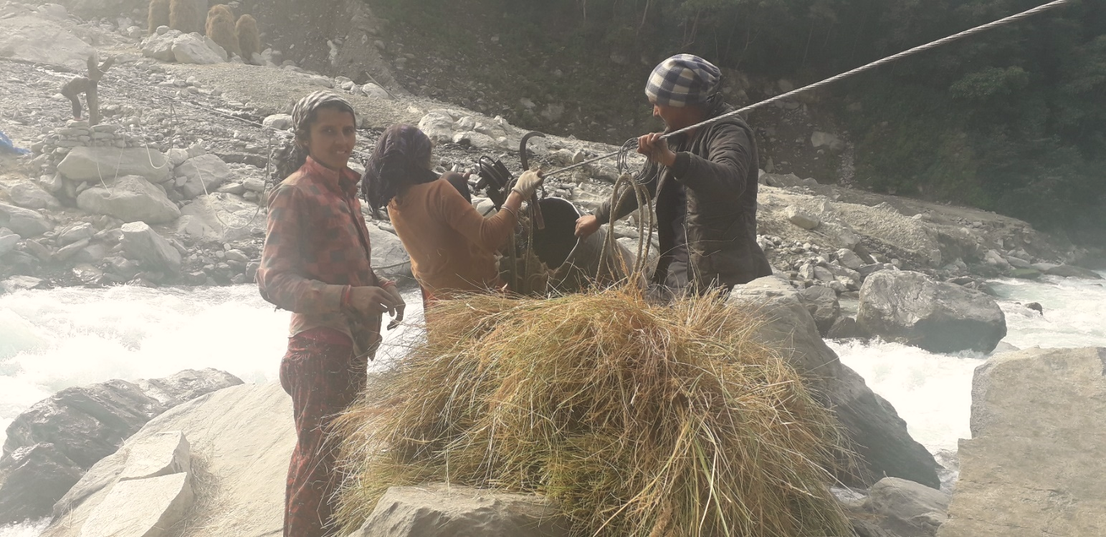
Team #BreakingTheBias
HIMAWANTI Nepal
ICIMOD:
Kamala Gurung
Srijana Joshi
Binaya Pasakhala
Sushmita Kunwar
Special thanks:
Sunayana Basnet

Slide 9
Notes:
Use one slide from three options to end your presentation

