Slide 1
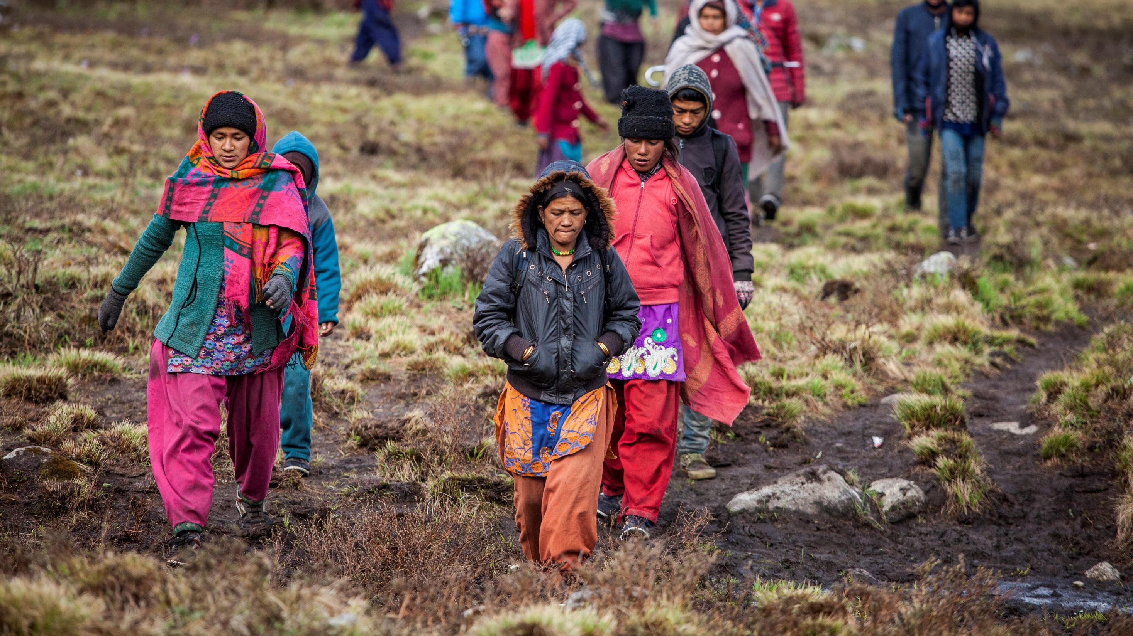
An overview of gender gaps in the HKH
Chanda Gurung Goodrich
8 March 2022

Slide 2
Indicators at sub-national level – Province/state
Demography
Total population; age group-wise; maternal and child mortality
Literacy and Education
Literacy rate; enrollment and drop-out rates; education levels
Employment
Employment/economic participation rate; unemployment rate; sector-wise employment
Political representation
National parliament; state/provincial legislatures
Background

Slide 3
Bangladesh
Male
Female
National Male
National Female
Source: Projected data based on Census 1991, 2001 and 2011

Slide 4
Bangladesh
Source: Election Commission of Bangladesh, 2015; Bangladesh Bureau of Statistics, 2019

Slide 5
China
Labour force participation rate (Aged 15 years and above), 2019**
Male
Female
National Male
National Female
Source: *Projected from National Census of 2000 and 2010
| **Women and Men in China - Facts and figures in 2019

Slide 6
China
Source: Statistical Monitoring Report, 2019
Source: China Women's Development Programme (2011-2020)

Slide 7
India
Male
Female
National Male
National Female
Source: *Projected from National Census of 2001 and 2011 | **Periodical Labour Survey Report 2021

Slide 8
India
Men
Women
Sources: *National Informatics Centre (2021)
**https://www.india.gov.in/my-government/whos-who/mlasmlcs; https://assam.gov.in/about-us/395; https://arla.neva.gov.in/ContactDirectory/MenuContactDirec; https://prsindia.org/mlatrack?state=Uttarakhand
https://prsindia.org/mlatrack?state=Himachal%20Pradesh; https://www.sikkim.gov.in/departments/sikkim-legislative-assembly

Slide 9
Pakistan
Male
Female
National Male
National Female
Source: *National Census 2017 | **Labour Force Survey 2017

Slide 10
Pakistan
Men
Women
Source: Election Commission of Pakistan; Election Commission of AJK Election Commission of GB

Slide 11
Notes:
Use one slide from three options to end your presentation

